Slide 1
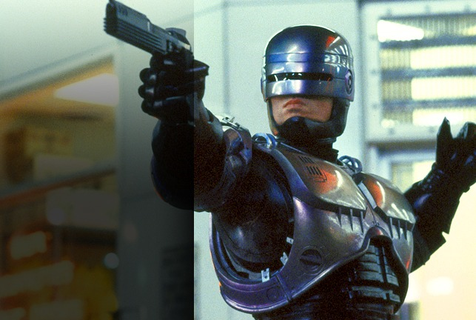
RoboCop: To be, or not to be?
Can he exist…
in today’s society?

Slide 2
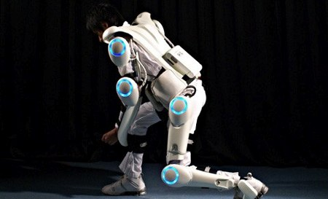
Powered Exoskeleton
Notes:
HAL Suit developed by Cyberdyne
Why?
Helps hold the weight of the armor
Gives the user extra strength
Allows disabled officers to return to the field
Is it read?
Yes
Costs 4200
Available to the public
The exoskeleton can carry a weight of 150 pounds without the Robo-Cop feeling it.
VIDEO

Slide 3
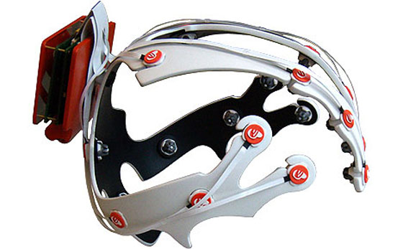
Brain Computer Interfaces
Notes:
Brain Computer Interfaces
What?
Allows a person to control a computer
Reads electrical impulses from the brain and decodes them
What kind?
Invasive
Nodes must be drilled into the head.
Permanent
Clearer electrical imagine
High risk of permanent damage
Non-Invasive
Non invasive is preferred since it doesn’t require cutting open the skull to pass wires
Non-Permanent, easily maintable.
Why?
Allows the computer to determine how the HAL the person is intending to move.
Gives officer a “HUD” based on current situations and what the best course of action is.
Is it ready?
No, but soon will be
Current tech allows for humans to play basic games such as pong and flight simulators

Slide 4
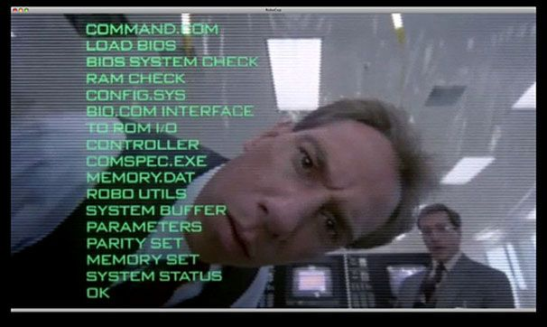
Robocop Software
Notes:
He runs DOS!

Slide 5
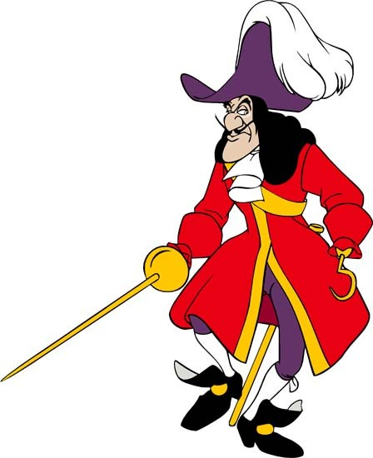
A historical pirate holding a massive sword and wielding a razor sharp hook. And something coming out between his legs.

Slide 6

The modern day pirate notice the grenade launcher and walkie-talkie.

Slide 7
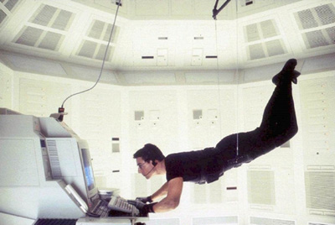
From the movie Mission Impossible. Tom cruise stealing classified information. He accomplishes this theft using wires and pulleys.

Slide 8

Morality is in the eye of the beholder

Slide 9
A Robo-Cop is both 50% Robo and 50% Cop
Robo(50%)
Cop(50%)
A Robo-Cop can also be 25% Robo and 75% Cop
Robo(25%)
Cop(75%)

Slide 10
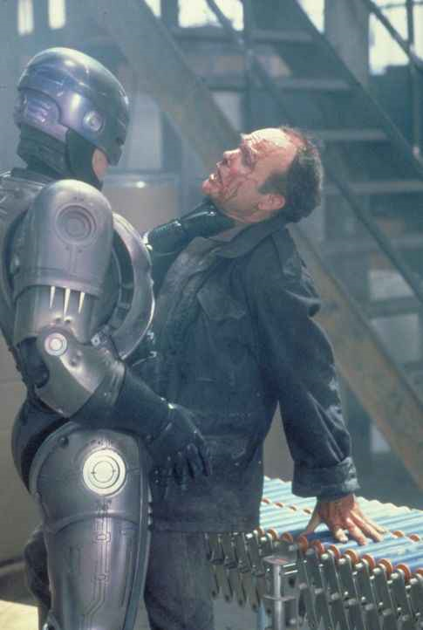
Machines are capable of murder!

Slide 11
